Slide 1
Programming JAVA {
Hiveed.java
POLYMORPHISM;
/* Here is where your journey for your dream begins */
}
JAVA Programming

Slide 2
Hiveed.java
What is Polymorphism in java :
The Word polymorphism is deriverd from the greek.
The member or object showing a different behaviour with the same name is as polymorphism.
Method Binding :
The method caller is associated with its implementation is knowm as method binding.
JAVA Programming

Slide 3
Hiveed.java
Polymorphism
Runtime
Polymorphism
Compile
Polymorphism
JAVA Programming

Slide 4
Hiveed.java
Compile Polymorphism
The method caller is associated with the method implementation during the compile time by the compiler is known as compile time polymorphism.
It is classfied into Four Types
Method Overloading.
Constructor Overloading.
Variable Shadowing.
Method Shadowing.
JAVA Programming

Slide 5
Hiveed.java
Method Overloading :
A Class have more than one method with same method name but different formal argument is called the Method Overloading.
Constructor Overloading :
A Class have more than one Constructor with same name but different formal argument is called the Construcor Overloading.
Method Shadowing :
Parent Class and child have same static method name and same formal argument.
JAVA Programming

Slide 6
Hiveed.java
Variable Shadowing :
A class have same variable name in different scope is called the variable shadowing.
Note :
Method Shadowing is only applicable for static method Only.
JAVA Programming

Slide 7
Hiveed.java
RunTime PolyMorphism :
The method caller is associated with the method implementation during the compile time by the Runtime is known as compile time polymorphism.
Example for Runtime polymorphism is Method Overriding.
Method Overriding :
When a parent and child Class have a same method name and same number , same type of the argument is called the method overloading .
JAVA Programming

Slide 8
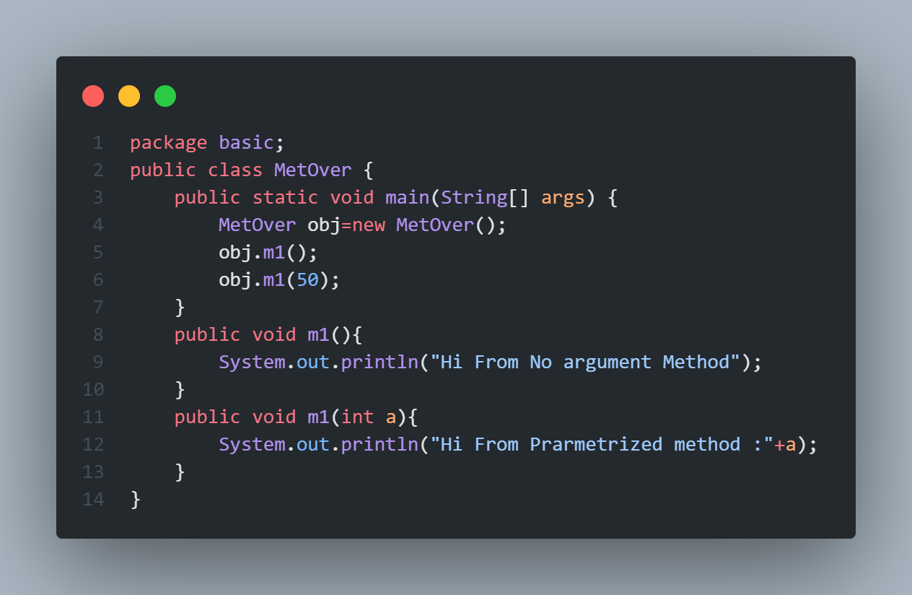
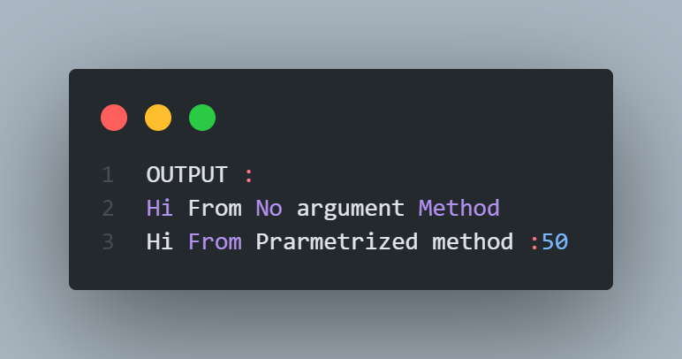
Hiveed.java
Example of method Overloading :
JAVA Programming

Slide 9
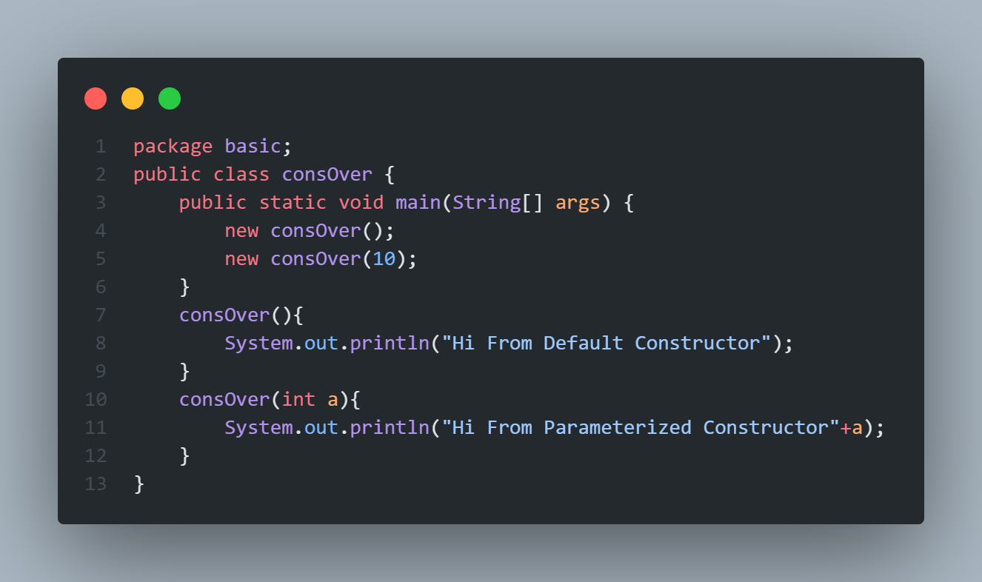
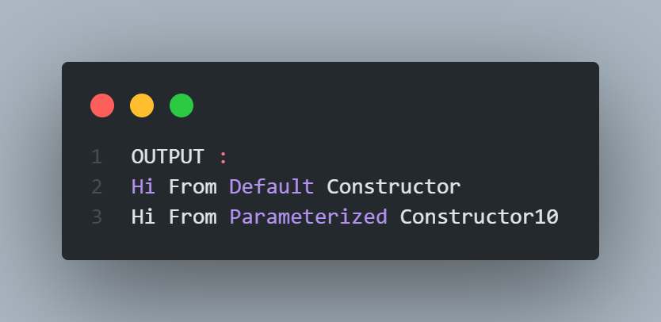
Hiveed.java
Example of Constructor Overloading :
JAVA Programming

Slide 10
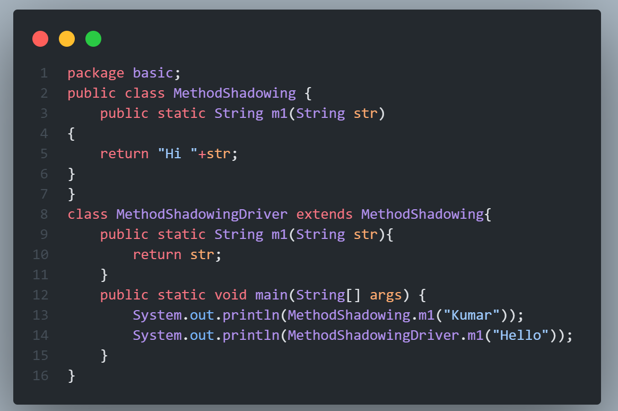
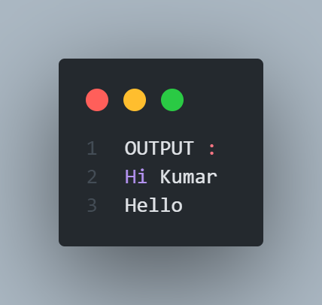
Hiveed.java
Example of Method Shadowing :
JAVA Programming

Slide 11
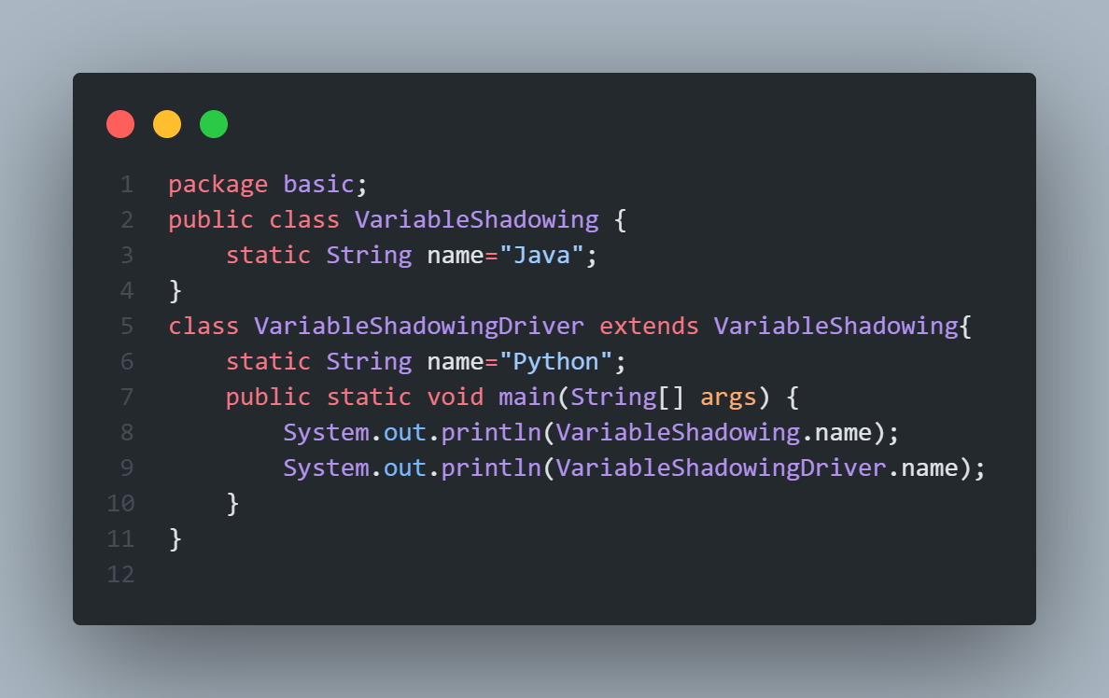
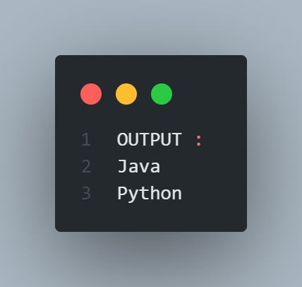
Hiveed.java
Example of Variable Shadowing :
JAVA Programming

Slide 12
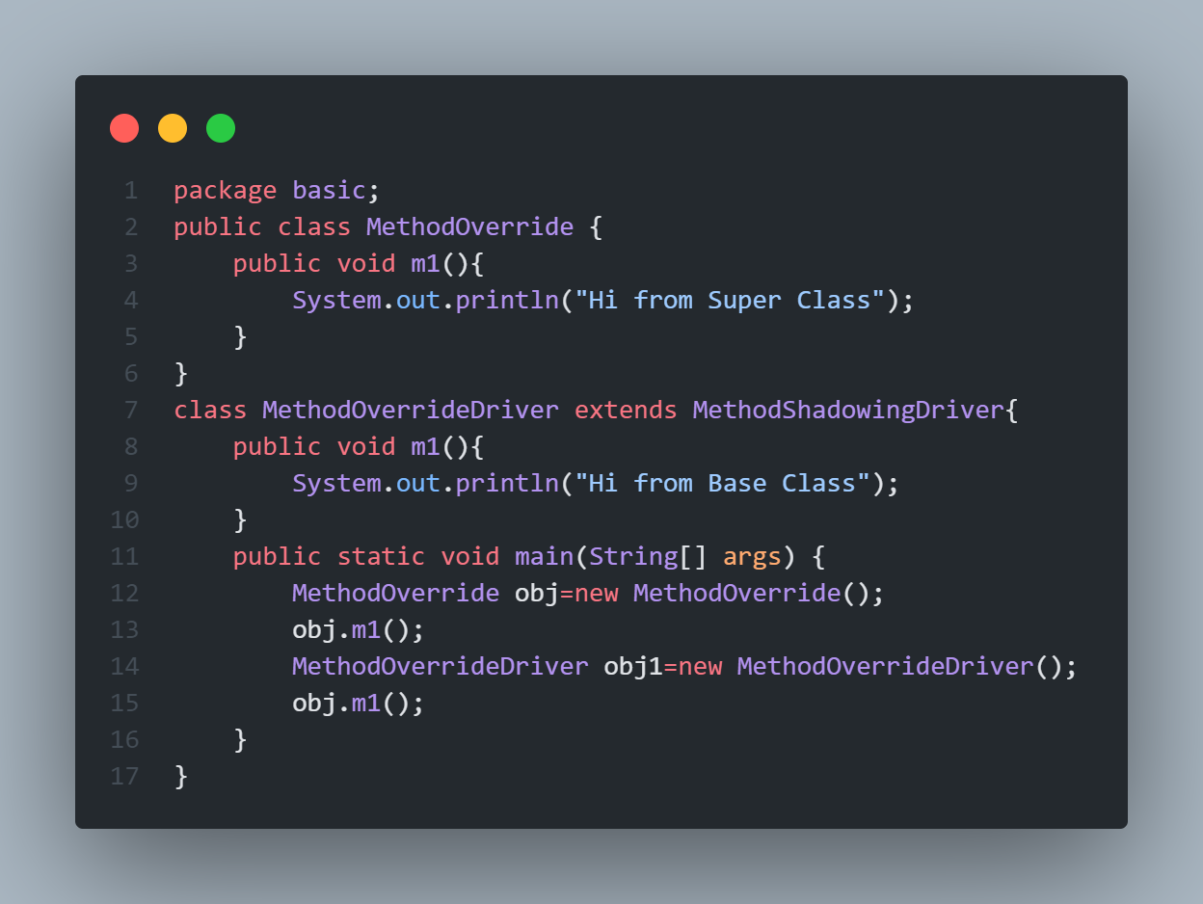
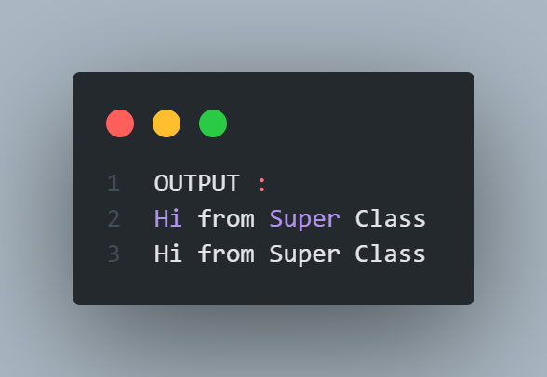
Hiveed.java
Example of Method Overriding :
JAVA Programming

